Slide 1

베이즈 통계 심화스터디 week 6-2 Hierarchical Modeling
배시예

Slide 2
Hierarchical Model
Bayesian hierarchical modelling is a statistical model written in multiple levels (hierarchical form) that estimates the parameters of the posterior distribution using the Bayesian method
Hyperparameters: parameters of the prior distribution
Hyperpriors: distributions of Hyperparameters

Slide 3
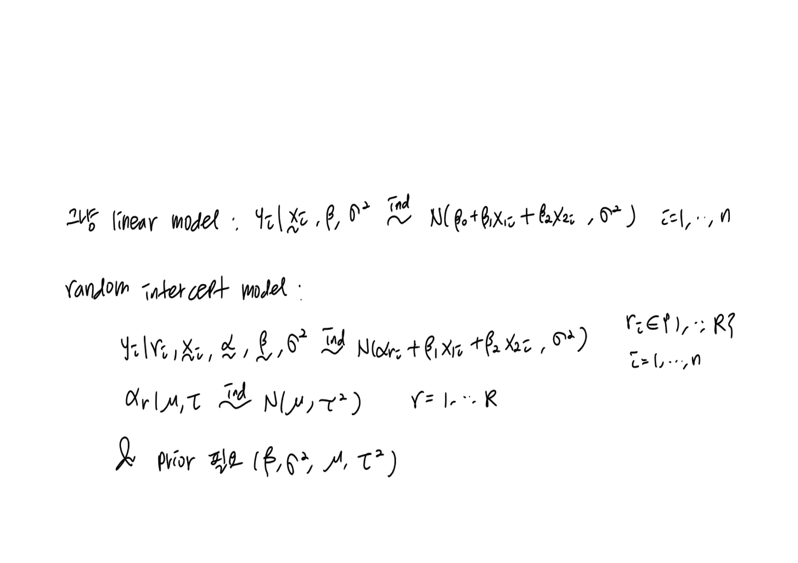
Linear regression

Slide 4
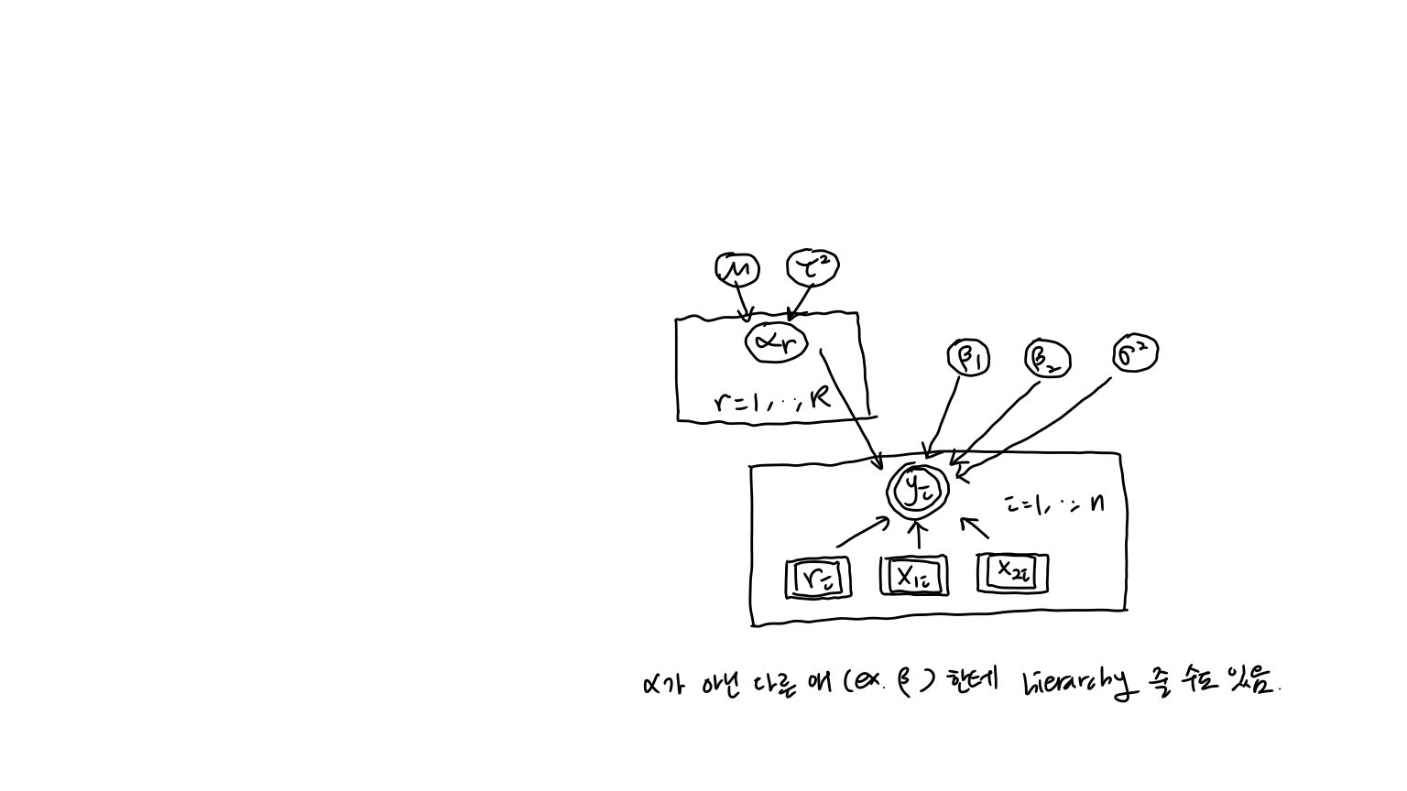
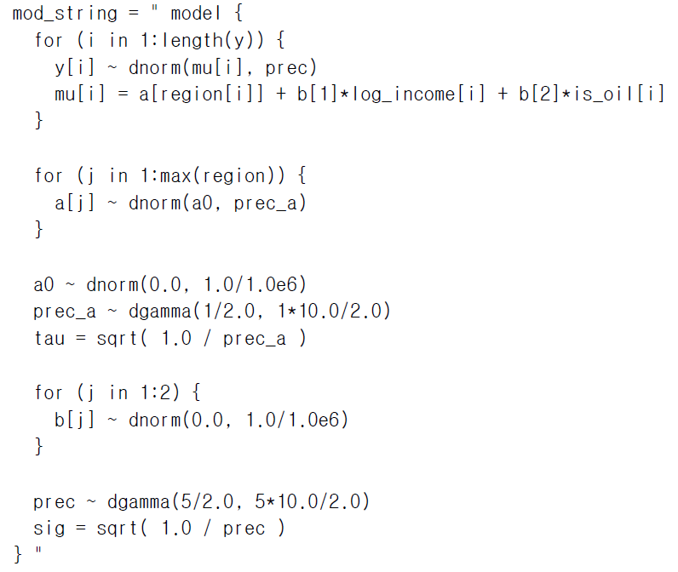
Linear regression

Slide 5
Applications: Mixed effects models
a mixed model, mixed-effects model or mixed error-component model is a statistical model containing both fixed effects and random effects.

Slide 6
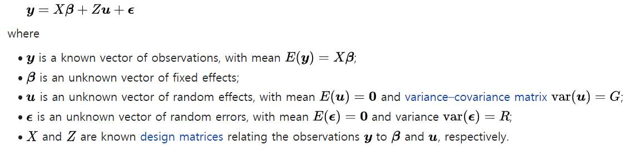

Applications: Mixed effects models
"mixed model equations" (MME)

Slide 7
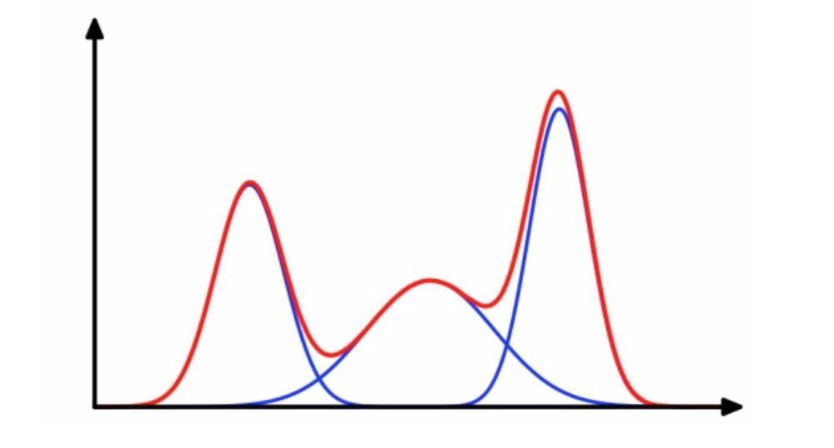
Applications: Mixture models
a mixture model is a probabilistic model for representing the presence of subpopulations within an overall population, without requiring that an observed data set should identify the sub-population to which an individual observation belongs.

Slide 8
Applications: Generalized linear model
the generalized linear model (GLM) is a flexible generalization of ordinary linear regression that allows for response variables that have error distribution models other than a normal distribution.

Slide 9
Applications: Time series data
correlated
parameters evolve in time
state space models, hidden Markov models

Slide 10
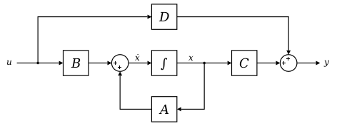
Applications
State space model (SSM) refers to a class of probabilistic graphical model (Koller and Friedman, 2009) that describes the probabilistic dependence between the latent state variable and the observed measurement.

Slide 11
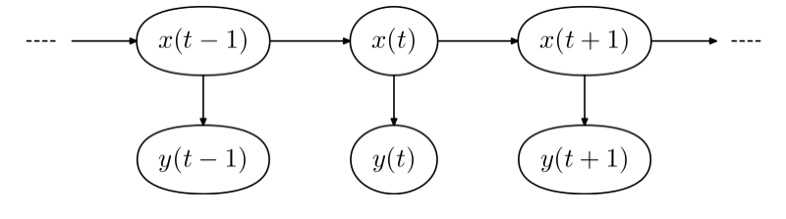
Applications
Hidden Markov Model (HMM) is a statistical Markov model in which the system being modeled is assumed to be a Markov process with unobservable ("hidden") states.

Slide 12
Applications: Spatial data
correlated
state space models, nonparametric models

Slide 13
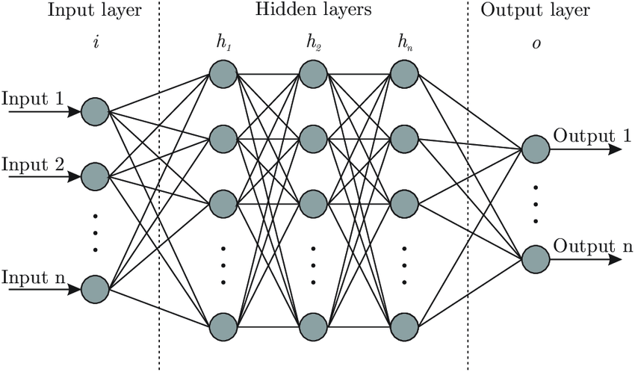
Applications: Neural networks
neurons: nonlinear relationships
intermediate nodes: latent variables

Slide 14
Applications: Nonparametric methods
Gaussian process prior
The Gaussian process is a nonparametric model in that there are infinitely many parameters characterizing the regression function

Slide 15
Applications: Nonparametric methods
Dirichlet process prior
The Dirichlet process is a infinite-dimensional generalization of the Dirichlet distribution that can be used to set a prior on unknown distributions.

